Slide 1
Uva 12086
Potentiometers
Time: 3 seconds

Slide 2
Problem Descriptions (1)
A potentiometer, or potmeter for short, is an electronic device with a variable electric resistance. It has two terminals and some kind of control mechanism (often a dial, a wheel or a slide) with which the resistance between the terminals can be adjusted from zero (no resistance) to some maximum value.

Slide 3
Problem Descriptions (2)
Resistance is measured in Ohms, and when two or more resistors are connected in series (one after the other, in a row), the total resistance of the array is the sum of the resistances of the individual resistors.

Slide 4
Problem Descriptions (3)
In this problem we will consider an array of N potmeters, numbered 1 to N from left to right. The left terminal of some potmeter numbered x is connected to the right terminal of potmeter x − 1, and its right terminal to the left terminal of potmeter x + 1.
The left terminal of potmeter 1 and the right terminal of potmeter N are not connected.

Slide 5
Problem Descriptions (4)
Initially all the potmeters are set to some value between 0 and 1000 Ohms.
Then we can do two things:
Set one of the potmeters to another value.
Measure the resistance between two terminals anywhere in the array.

Slide 6
Input (1)
The input consists less than 3 cases.
Each case starts with N, the number of potmeters in the array, on a line by itself. N can be as large as 200000.
Each of next N lines contains one numbers between 0 and 1000, the initial resistances of the potmeters in the order 1 to N.
Then follow a number of actions, each on a line by itself. The number of actions can be as many as 200000. There are three types of action:

Slide 7
Input (2)
“S x r” - set potmeter x to r Ohms. x is a valid potmeter number and r is between 0 and 1000.
“M x y” - measure the resistance between the left terminal of potmeter x and the right terminal of potmeter y. Both numbers will be valid and x is smaller than or equal to y.
“END” - end of this case. Appears only once at the end of a list of actions.
A case with N = 0 signals the end of the input and it should not be processed

Slide 8
Output
For each case in the input produce a line ‘Case n:’, where n is the case number, starting from 1.
For each measurement in the input, output a line containing one number: the measured resistance in Ohms. The actions should be applied to the array of potmeters in the order given in the input. Print a blank line between cases. Warning:
Input Data is pretty big (∼ 8 MB) so use faster IO.

Slide 9
Example I/O
3
100
100
100
M 1 1
M 1 3
S 2 200
M 1 2
S 3 0
M 2 3
END
10
1
2
3
4
5
6
7
8
9
10
M 1 10
END
0
Case 1:
100
300
300
200
Case 2:
55
1 | 2 | 3
100 | 100 | 100
100
300
1 | 2 | 3
100 | 200 | 100
300
1 | 2 | 3
100 | 200 | 0
200
1 | 2 | 3 | 4 | 5 | 6 | 7 | 8 | 9 | 10
1 | 2 | 3 | 4 | 5 | 6 | 7 | 8 | 9 | 10

Slide 10
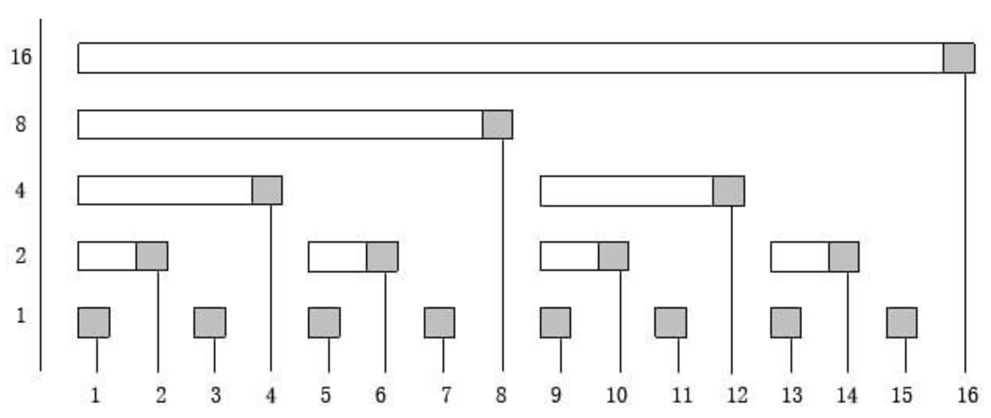
Fenwick Tree

Slide 11
Lowbit(k)
Lowbit(k) = k & -k
Example:
0100₂ ₍₄₎& 1100₂ ₍₋₄₎= 0100₂
0101₂ ₍₅₎& 1011₂ ₍₋₅₎= 0001₂

Slide 12
Create FT (1)
k+=lowbit(k)
k=0001
k=0100
k=1000
k=10000
k=0010

Slide 13
Create FT (2)
k+=lowbit(k)
k=0010
k=0100
k=1000
k=10000

Slide 14
Create FT (3)
k+=lowbit(k)
k=0011
k=1000
k=10000
k=0100

Slide 15
Create FT (4)
k+=lowbit(k)
k=0100
k=1000
k=10000

Slide 16
Create FT (5)
k+=lowbit(k)
k=0101
k=1000
k=10000
k=0110

Slide 17
Create FT (6)
k+=lowbit(k)
k=0110
k=1000
k=10000

Slide 18
Create FT (7)
k+=lowbit(k)
k=0111
k=10000
k=1000

Slide 19
RSQ (Range Sum Query)
k-=lowbit(k)
RSQ(k)
0100
0110
0111

Slide 20
RSQ (Range Sum Query)
k-=lowbit(k)
RSQ(k)
1000
1100

Slide 21
RSQ (Range Sum Query)
RSQ(a,b) = RSQ(b)-RSQ(a-1)
RSQ(7,12) = RSQ(12)-RSQ(6)

Slide 22
Update FT
k+=lowbit(k)
k=0001
k=0100
k=1000
k=10000
k=0010

Slide 23
BIT, add( ), sum( ), rsum( )
void add (int x, int d)
{ while (x<=n)
{ c[x]+=d; x+=lowbit(x);}
}
int sum(int x)
{ int ret=0;
while (x>0)
{ ret+=c[x]; x-=lowbit(x);}
return ret;
}
int rsum(int x, int y)
{ return( sum(y)-sum(x-1) );
}

Slide 24
Example: Create FT
1 | 2 | 3 | 4 | 5 | 6 | 7 | 8 | 9 | 10
3 | 4 | 7 | 1 | 2 | 5 | 6 | 8 | 2 | 3
1 | 2 | 3 | 4 | 5 | 6 | 7 | 8 | 9 | 10
0 | 0 | 0 | 0 | 0 | 0 | 0 | 0 | 0 | 0
1 | 2 | 3 | 4 | 5 | 6 | 7 | 8 | 9 | 10
3 | 3 | 0 | 3 | 0 | 0 | 0 | 3 | 0 | 0
k=1
1 | 2 | 3 | 4 | 5 | 6 | 7 | 8 | 9 | 10
3 | 7 | 0 | 7 | 0 | 0 | 0 | 7 | 0 | 0
k=2
1 | 2 | 3 | 4 | 5 | 6 | 7 | 8 | 9 | 10
3 | 7 | 7 | 14 | 0 | 0 | 0 | 14 | 0 | 0
k=3

Slide 25
Example: Create FT
1 | 2 | 3 | 4 | 5 | 6 | 7 | 8 | 9 | 10
3 | 4 | 7 | 1 | 2 | 5 | 6 | 8 | 2 | 3
1 | 2 | 3 | 4 | 5 | 6 | 7 | 8 | 9 | 10
3 | 7 | 7 | 15 | 0 | 0 | 0 | 15 | 0 | 0
k=4
1 | 2 | 3 | 4 | 5 | 6 | 7 | 8 | 9 | 10
3 | 7 | 7 | 15 | 2 | 2 | 0 | 17 | 0 | 0
k=5
1 | 2 | 3 | 4 | 5 | 6 | 7 | 8 | 9 | 10
3 | 7 | 7 | 15 | 2 | 7 | 0 | 22 | 0 | 0
k=6
1 | 2 | 3 | 4 | 5 | 6 | 7 | 8 | 9 | 10
3 | 7 | 7 | 15 | 2 | 7 | 6 | 28 | 0 | 0
k=7

Slide 26
Example: Create FT
1 | 2 | 3 | 4 | 5 | 6 | 7 | 8 | 9 | 10
3 | 4 | 7 | 1 | 2 | 5 | 6 | 8 | 2 | 3
1 | 2 | 3 | 4 | 5 | 6 | 7 | 8 | 9 | 10
3 | 7 | 7 | 15 | 2 | 7 | 6 | 36 | 0 | 0
k=8
1 | 2 | 3 | 4 | 5 | 6 | 7 | 8 | 9 | 10
3 | 7 | 7 | 15 | 2 | 7 | 6 | 36 | 2 | 2
k=9
1 | 2 | 3 | 4 | 5 | 6 | 7 | 8 | 9 | 10
3 | 7 | 7 | 15 | 2 | 7 | 6 | 36 | 2 | 5
k=10

Slide 27
Example: RSQ(6)
1 | 2 | 3 | 4 | 5 | 6 | 7 | 8 | 9 | 10
3 | 4 | 7 | 1 | 2 | 5 | 6 | 8 | 2 | 3
3+4+7+1+2+5=22
1 | 2 | 3 | 4 | 5 | 6 | 7 | 8 | 9 | 10
3 | 7 | 7 | 15 | 2 | 7 | 6 | 36 | 2 | 5
0110 (6) + 0100 (4) = 7+15=22

Slide 28
Example: RSQ(9)
1 | 2 | 3 | 4 | 5 | 6 | 7 | 8 | 9 | 10
3 | 4 | 7 | 1 | 2 | 5 | 6 | 8 | 2 | 3
3+4+7+1+2+5+6+8+2=38
1 | 2 | 3 | 4 | 5 | 6 | 7 | 8 | 9 | 10
3 | 7 | 7 | 15 | 2 | 7 | 6 | 36 | 2 | 5
1001 (9) + 1000 (8) = 2+36=38

Slide 29
Example: RSQ(7,9)
1 | 2 | 3 | 4 | 5 | 6 | 7 | 8 | 9 | 10
3 | 4 | 7 | 1 | 2 | 5 | 6 | 8 | 2 | 3
6+8+2=16
1 | 2 | 3 | 4 | 5 | 6 | 7 | 8 | 9 | 10
3 | 7 | 7 | 15 | 2 | 7 | 6 | 36 | 2 | 5
RSQ(9)=38
RSQ(6)=22
RSQ(7,9)=RSQ(9)-RSQ(6)=16

Slide 30
Time Complexity
Brute Force: O(n)
n queries: O(n²)
Create FT: O(n log n)
Update FT: O(log n)
Query FT: O(log n)
n queries: O(n log n)

